Slide 1

CSE310: Programming in Java
Topic: Branching Statements

Slide 2
Outlines
break Statement
continue Statement
return Statement

Slide 3
break Statement
break statement:
  terminates a statement sequence in a switch statement
  used to exit a loop
The break statement has two forms:
  labeled
  unlabeled.

Slide 4
Unlabeled break
An unlabeled break is used to terminate a for, while, or do-while loop and switch statement.
Example 1:
i: 0
i: 1
i: 2
i: 3
i: 4
i: 5
i: 6
i: 7
i: 8
i: 9
Loop completed
class Test {
public static void main(String[] args) {
for (int i = 0; i < 100; i++) {
if (i == 10) {
break;
}System.out.println("i: " + i);
}
System.out.println("Loop completed");
}
}
Notes:
0,1,2,3,4,5,6,7,8,9 loop completed

Slide 5
Labeled break Statement
Java defines an expanded form of the break statement.
break label;
By using this form of break, we can break out of one or more blocks of code.
When this form of break executes, control is transferred out of the named block.
When this break statement is encountered with the label/name of the loop, it skips the execution any statement after it and takes the control right out of this labelled loop.
And, the control goes to the first statement right after the loop.

Slide 6
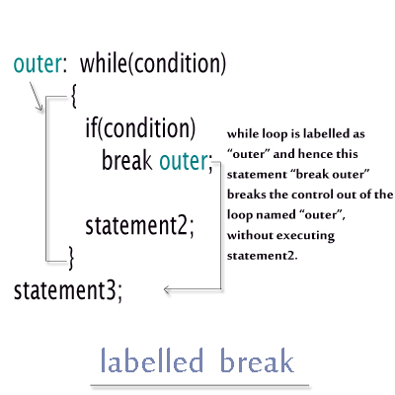
Concept

Slide 7
Output:
Outer 0
Inner 0
Bye
Inner 1
Bye
Inner 2
Bye
Outer 1
Inner 0
class Example
{
public static void main(String[] args)
{
outer:
for(int i=0; i<3; i++)
{
System.out.println("Outer "+ i);
inner:
for(int j=0; j<3; j++)
{
System.out.println("Inner "+j);
if(i== j+1)
break outer;
System.out.println("Bye");
}
}
}
}
Notes:
Outer 0
Inner 0
Bye
Inner 1
Bye
Inner 2
Bye
Outer 1
Inner 0

Slide 8
NOTE
The break statement terminates the labeled statement;
it does not transfer the flow of control to the label.
Control flow is transferred to the statement immediately following the labeled (terminated) statement.

Slide 9
continue Statement
The continue statement skips the current iteration of a for, while , or do-while loop.
The unlabeled form skips to the end of the innermost loop's body and evaluates the boolean expression that controls the loop.

Slide 10
class Example
{
public static void main(String[] args)
{
int i;
for(i=1;i<=10;i++)
{
if(i==5)
continue;
System.out.println(i);
}
}
}
Output:
1
2
3
4
6
7
8
9
10
Notes:
Number of s inShe saw a ship in the sea=3

Slide 11
Labeled continue Statement
A labeled continue statement skips the current iteration of an outer loop marked with the given label.
In Labelled Continue Statement, we give a label/name to a
loop
When this continue statement is encountered with the label/name of the loop, it skips the execution any statement within the loop for the current iteration and continues with the next iteration and condition checking in the labelled loop.

Slide 12
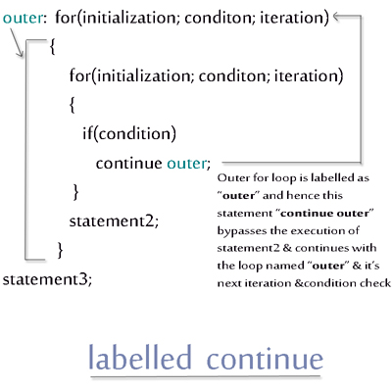
Concept
Notes:
0
Hi
0
1
Hi
0
2
4
Done

Slide 13
Example
public class Main
{
public static void main (String[]args)
{
loop:
for (int i = 0; i < 2; i++)
{
for (int j = 0; j < 5; j++)
{
if (j == 2)
continue loop;
System.out.println ("i =" + i + " j =" + j);
}
}
System.out.println ("Out of the loop");
}
}
Output:
i=0 j=0
i=0 j=1
i=1 j=0
i=1 j=1
Out of the loop

Slide 14
return Statement
The return statement exits from the current method, and control flow returns to where the method was invoked.
The return statement has two forms: one that returns a value, and one that doesn't.
To return a value, simply put the value (or an expression that calculates the value) after the return keyword.
return ++count;

Slide 15
return Statement
The data type of the returned value must match the type of the method's declared return value.
When a method is declared void, use the form of return that doesn't return a value.
return;

Slide 16
class Mymath {
int sum(int a, int b) {
return a+b; // return statement
}
}
public class Test {
public static void main(String[] args) {
Mymath a = new Mymath(); // reference is Animal, but object is Dog
int x=a.sum(5,7);
System.err.println(x);
}
}

Slide 17
Output??
public class Main
{
public static void main (String[]args)
{
label:
for(int i=0; i<2; i++)
{
for(int j=0; j<2; j++)
{
System.out.println(i + ", "+ j);
if(j!=2)
continue label;
}
}
}
}
0,0
1,0
1,1
0,0
0,1
1,1

Slide 18

Ans: A

Slide 19
Output??
public class Main
{
public static void main (String[]args)
{
label:
for (int i = 0; i < 2; i++)
{
for (int j = 0; j < 2; j++)
{
if (j>0)
break label;
System.out.print(i+" ");
}
}
}
}
1
0 1
1 0
0

Slide 20
Ans:D

Slide 21
Output??
public class Main
{
public static void main (String[]args)
{
label1:
for (int i = 1; i <=2; i++)
{
label2:
for (int j = 2; j <=5; j++)
{
System.out.print(j+" ");
if (j%2==0)
break label1;
else
continue label2;
}
}
}
}
2
1 3 5
1 3
3 5

Slide 22
Ans:A

Slide 23
Output??
public class Main
{
public static void main (String[]args)
{
int i=1,j=1;
label1:
while(i<=2)
{
i++;
while(j<=2)
{
j++;
System.out.println(i);
if(i==j)
break label1;
}
}
}
}
1
2
1 2
2 2

Slide 24
Ans:B

Slide 25


